Slide 1

Rattle Info
This assignment was meant to test my ability to create a responsive website

Slide 2

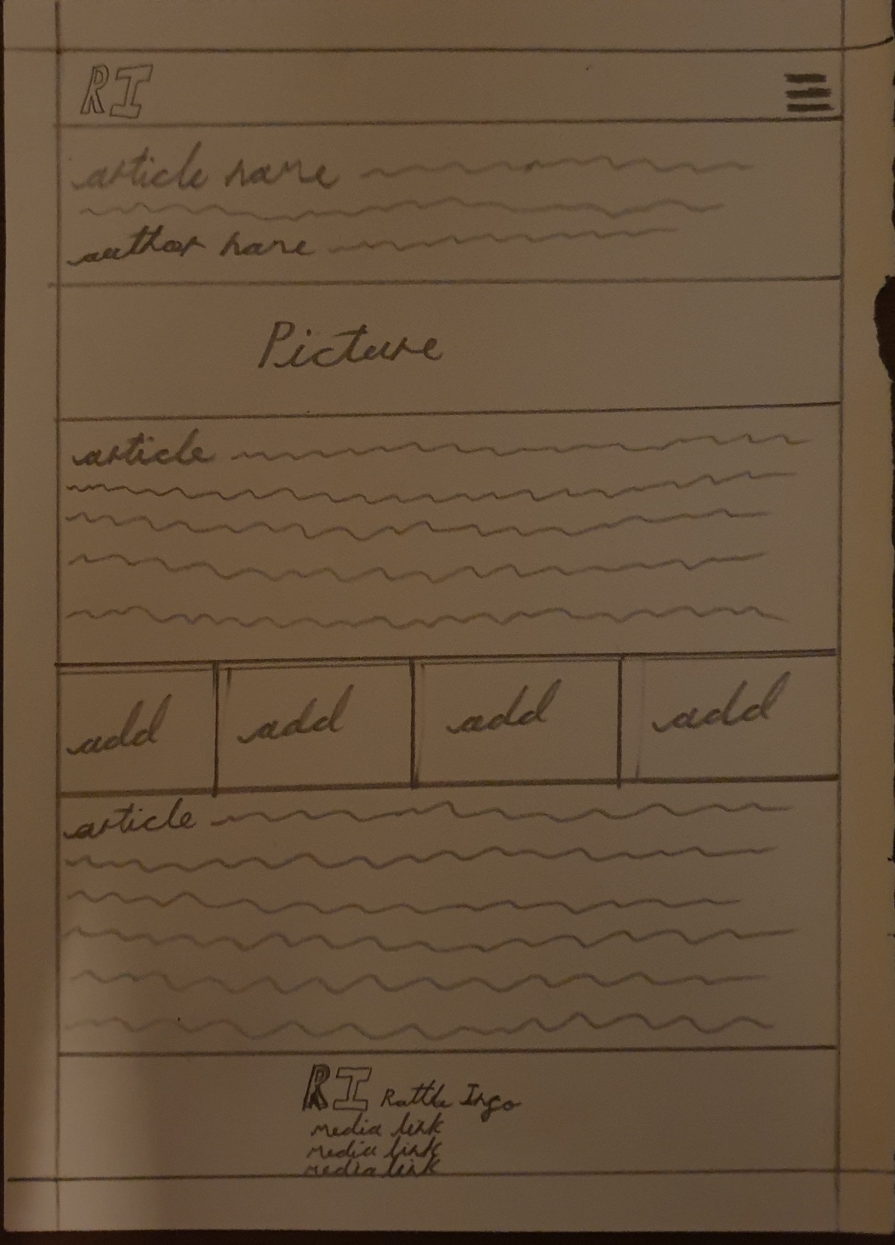
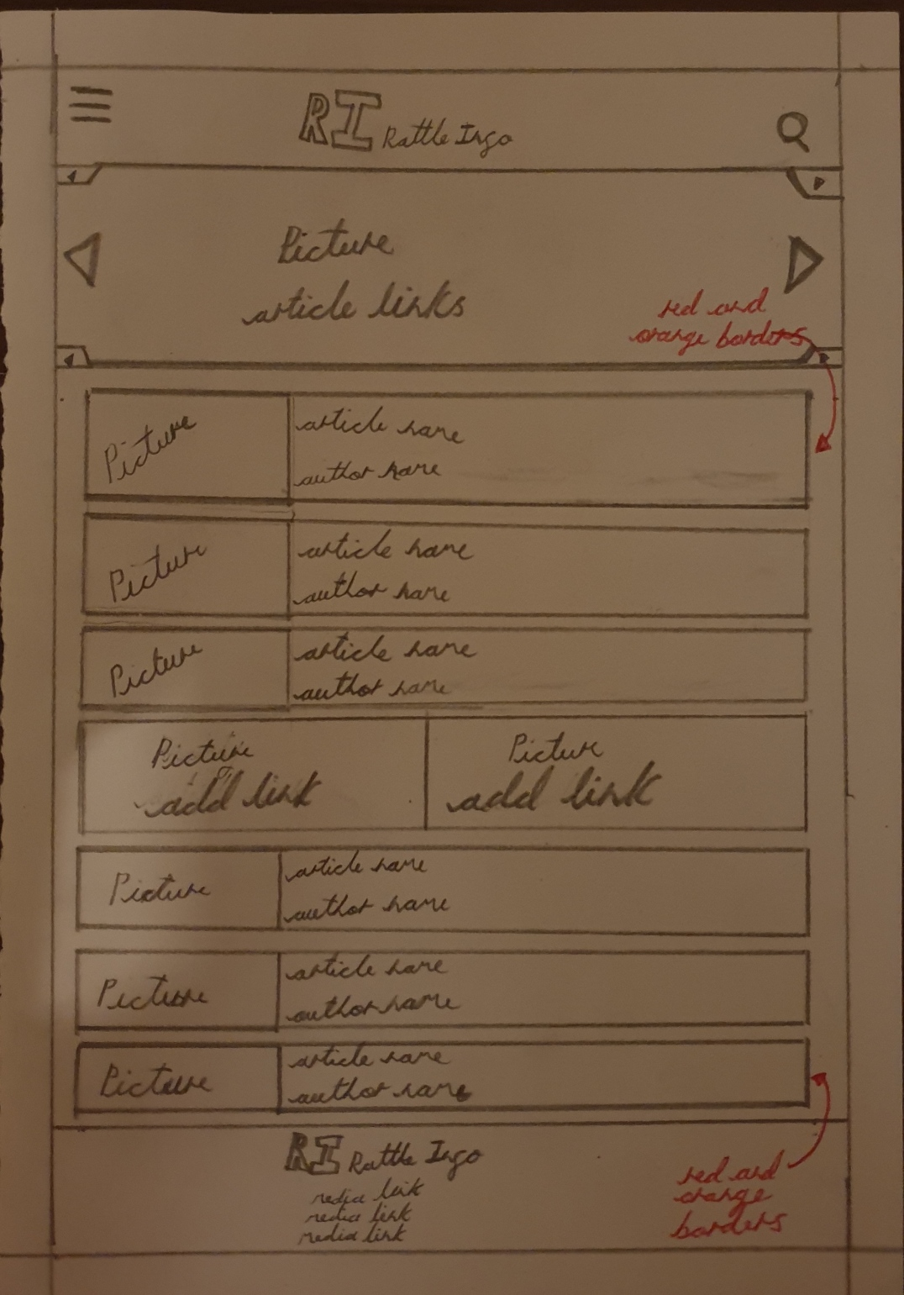

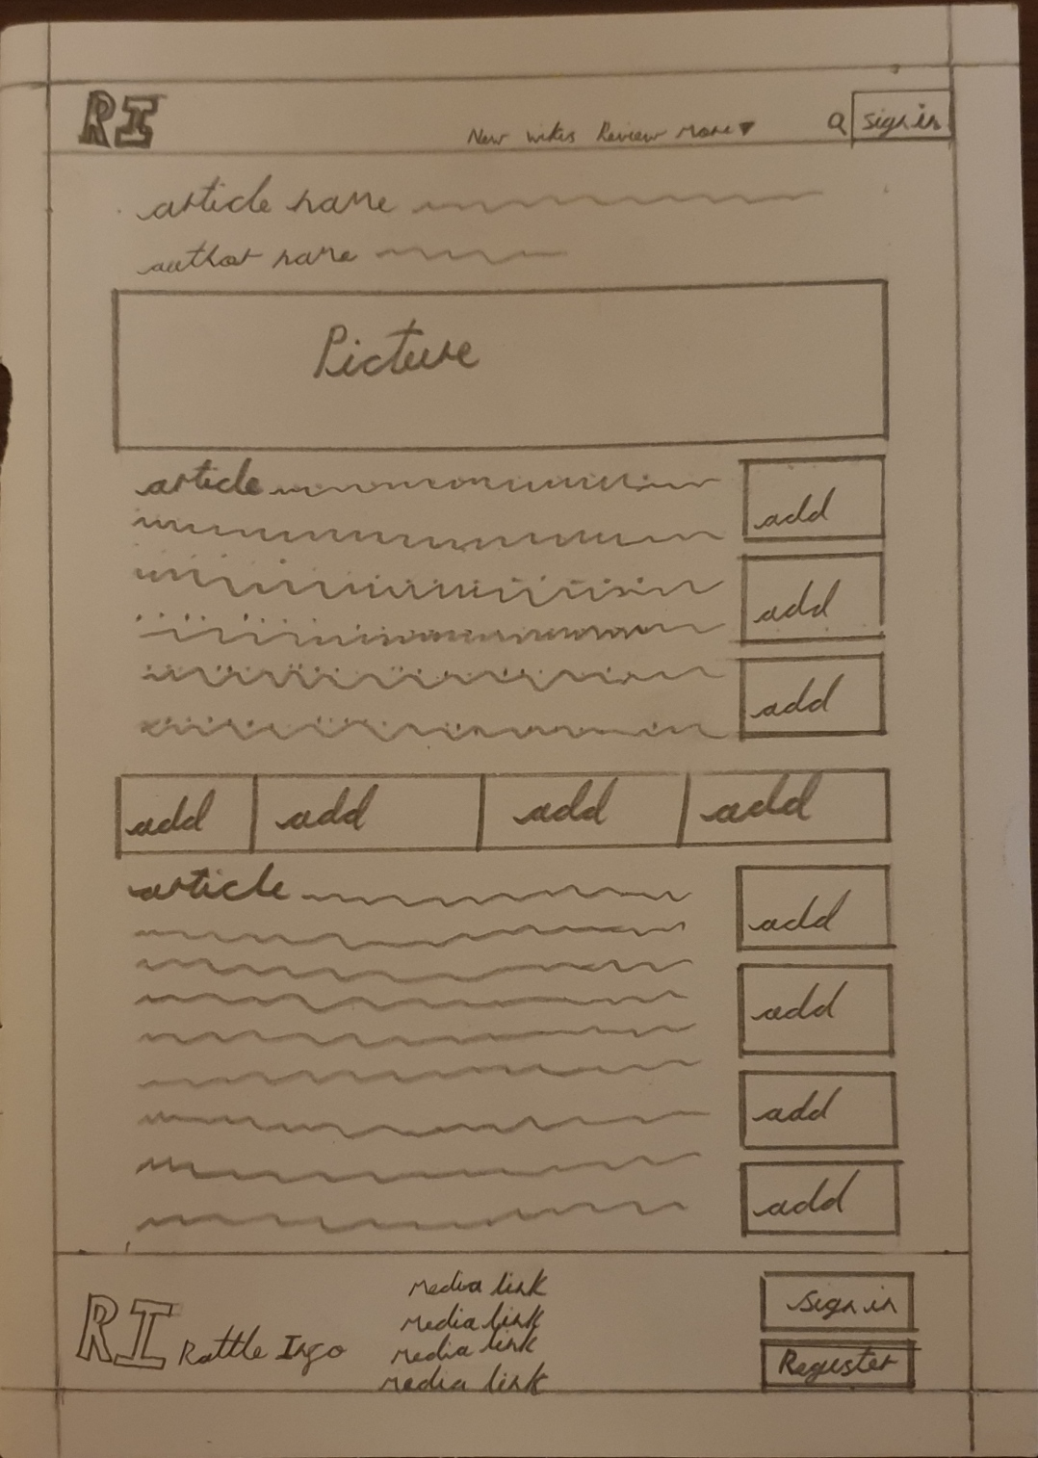
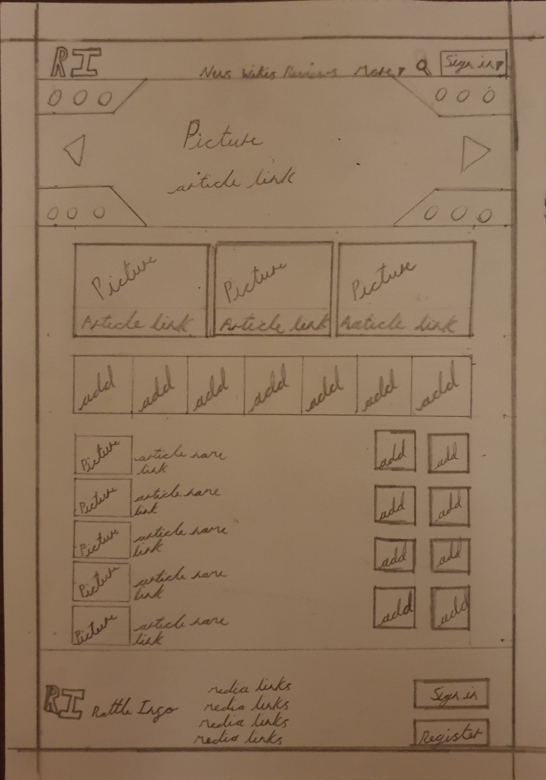
Design Phase
The design phase was meant a research, I looked for gamming news sites on the internet and bookmarked the best 3 I liked (IGN, The Verge, Polygon). After that was done I created sketches or moodboards of what I roughly wanted my website to look like. During this phase of the project we were also asked to create 2 personas of people our sites would be aimed at.

Slide 3
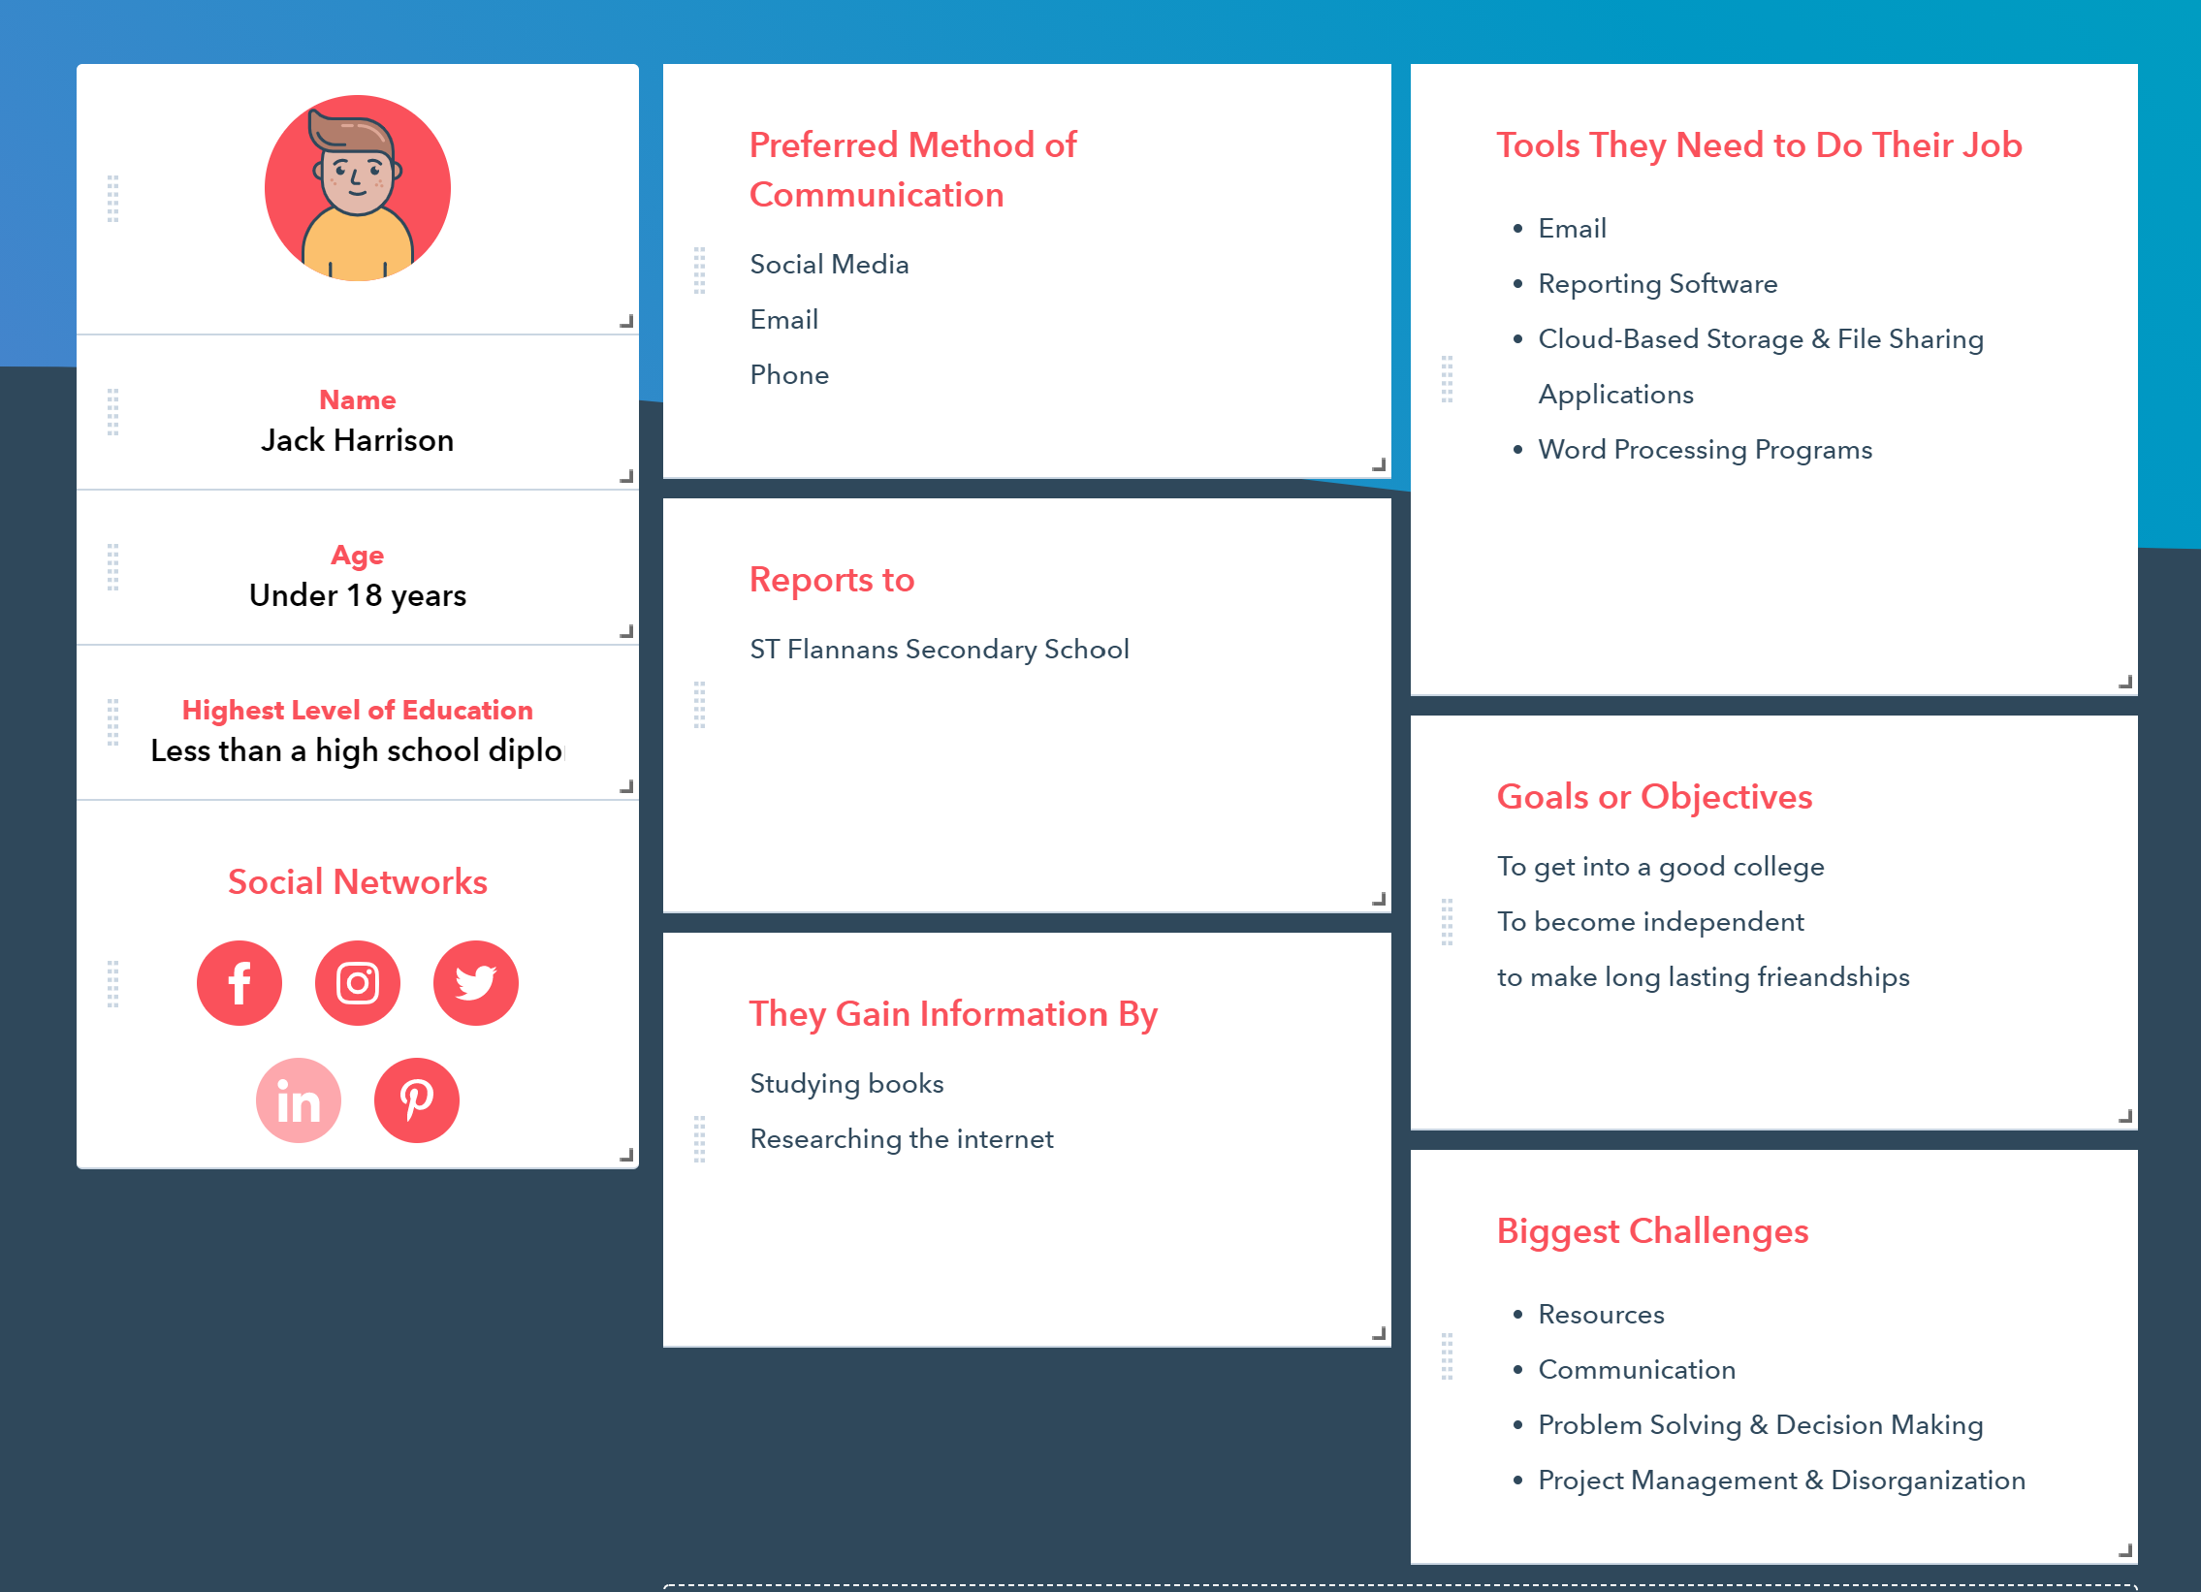
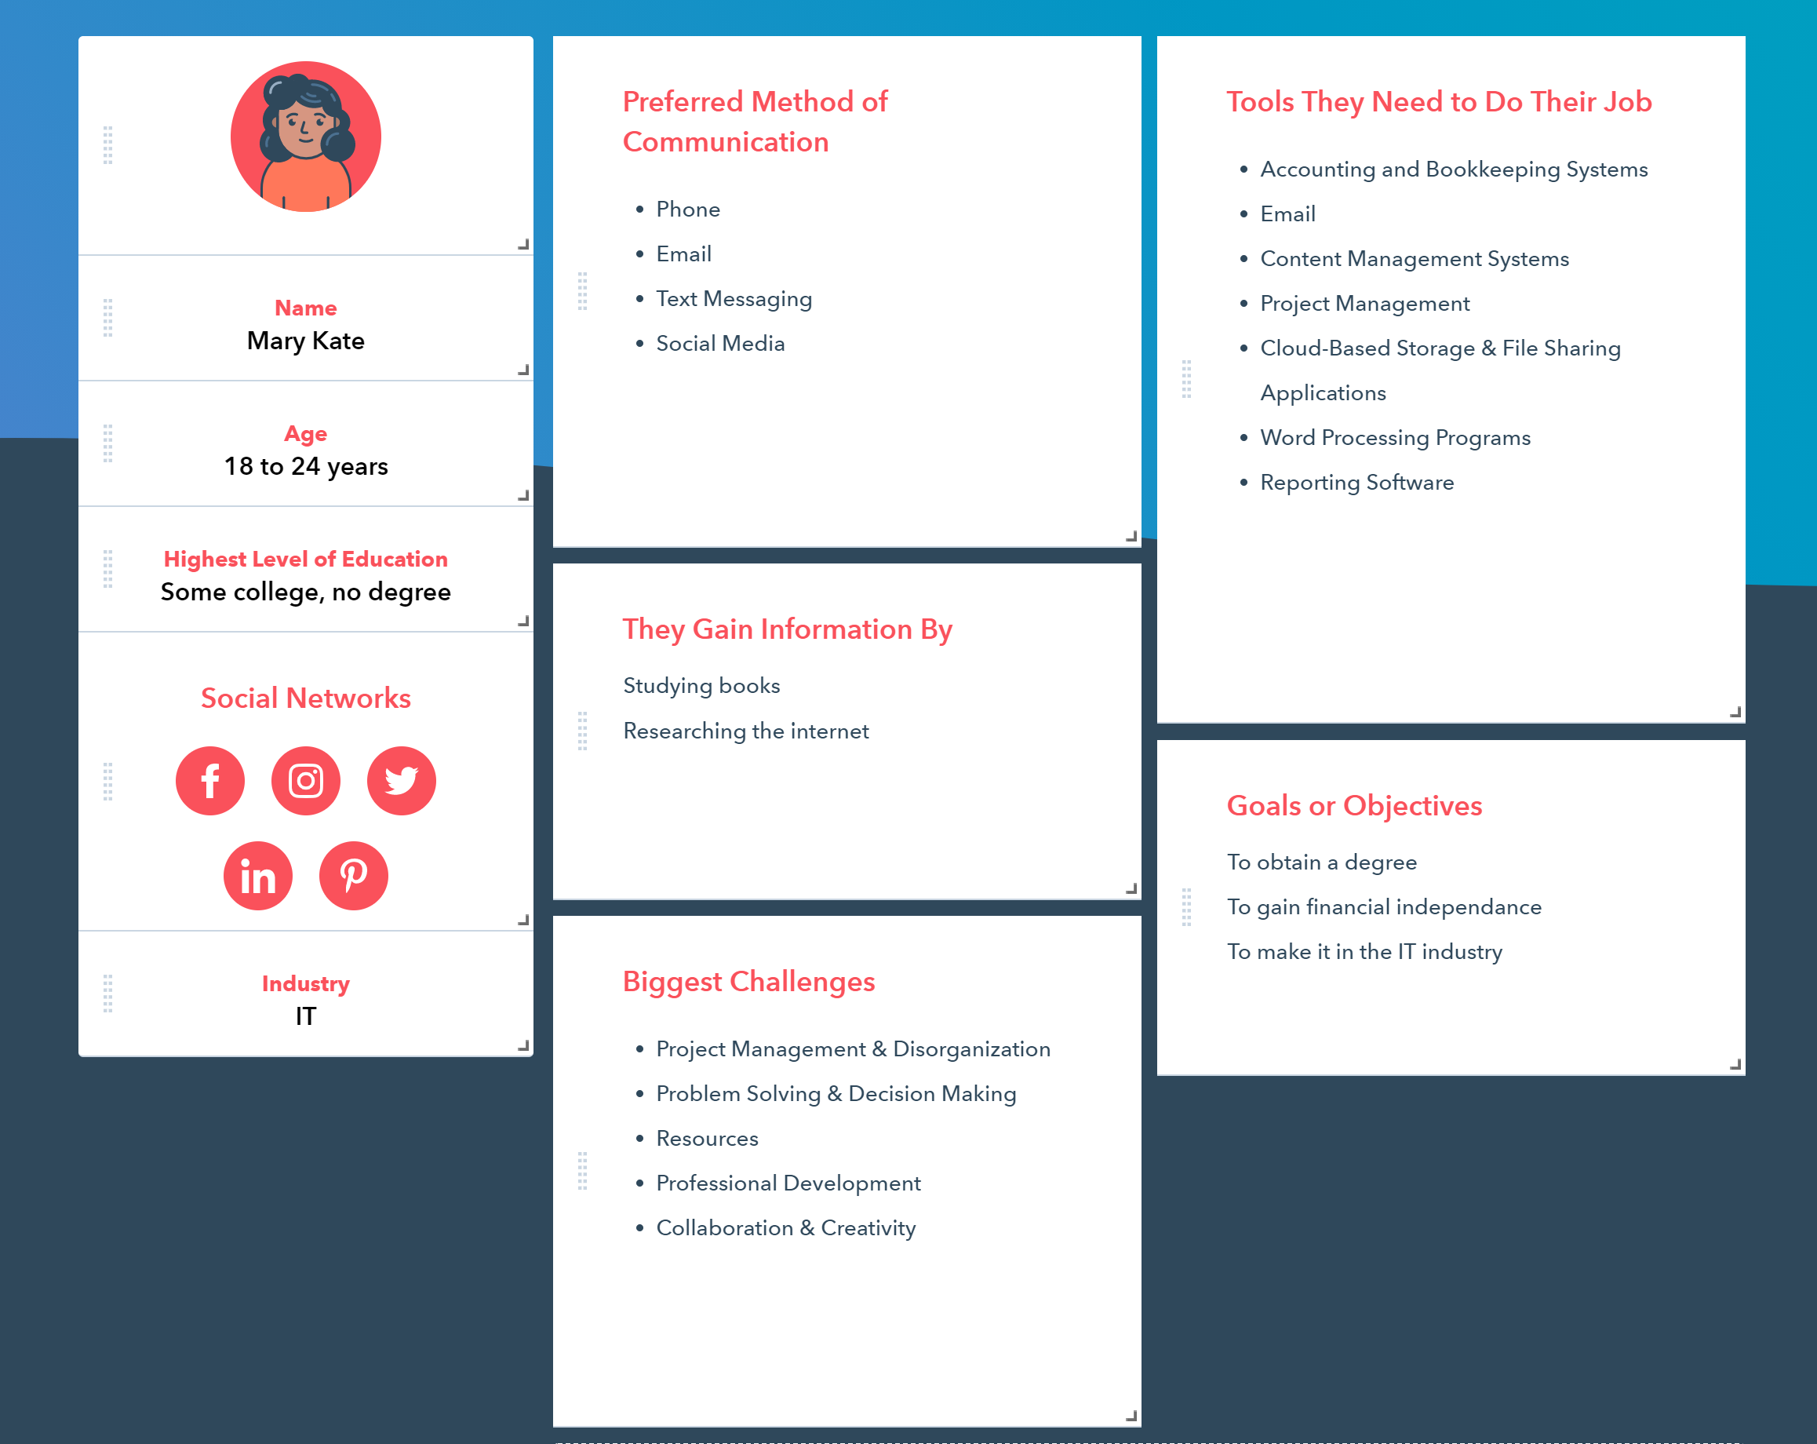
Personas

Slide 4
Phase 2 Project Stages
For this phase we were tasked with finishing up our design and making the final website. My website has 9 pages in total, a home page, a news page, a login page, a signup page, and 5 articles. I came across many challenges while making this website, the most challenging part of this project was the carousel I add. I knew a wanted a carousel but I had no idea how I was going to implement it as I had never made them before, however after looking helpful websites like my3schools I was able to get one working. this was by far the most challenging feature to add to my website,

Slide 5
Home Page
I decided to keep my home page simple as this is the page people will first land on and I wanted to make navigation easy for users. My home page has a nav bar at the top, right below that is the carousel with sliding images, then there are 3 adds I add in a card shape.

Slide 6
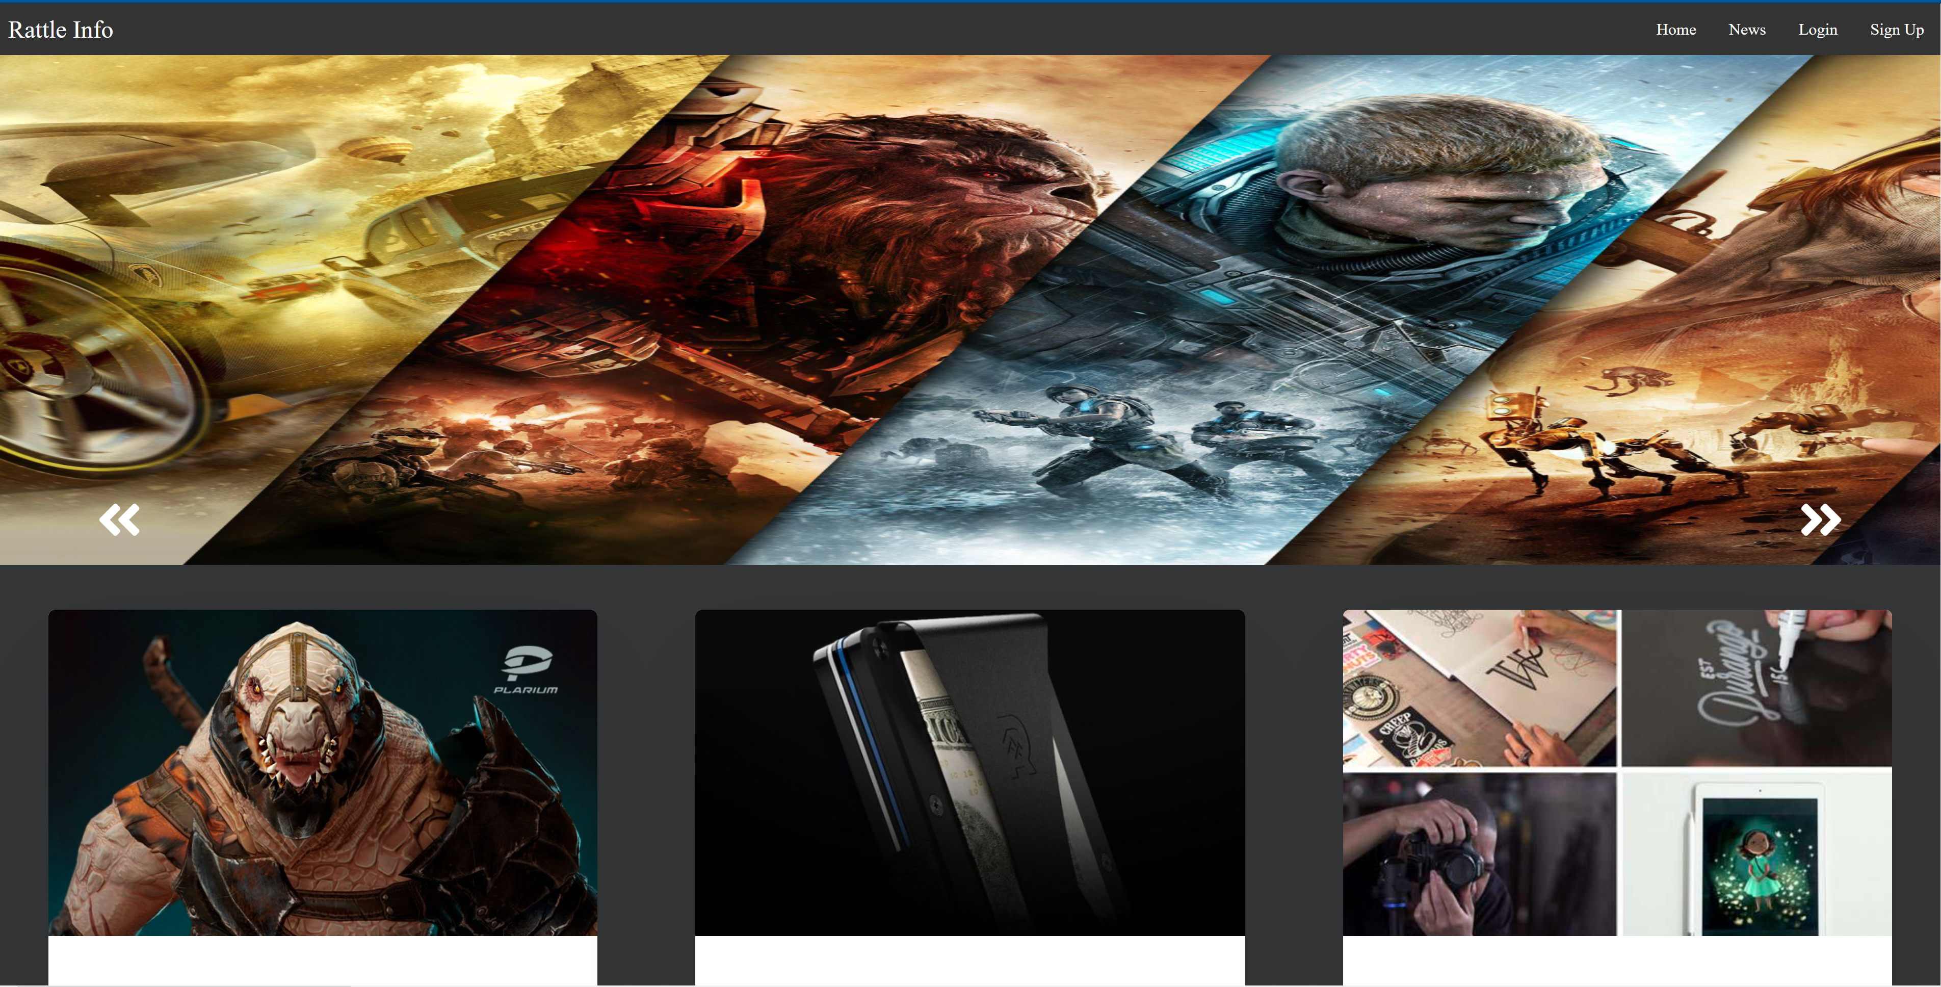
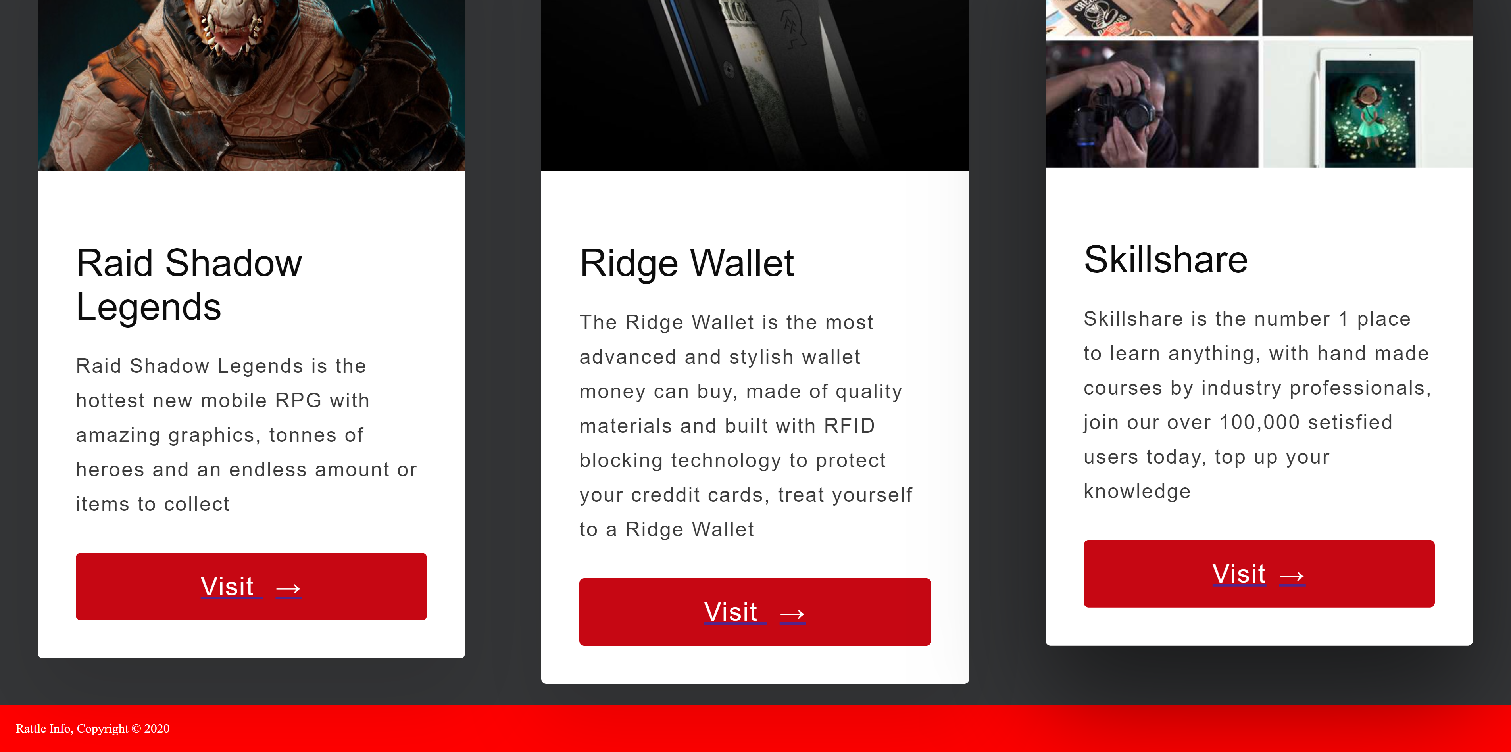
Home Page

Slide 7
Login Page
Form my login page I made a normal login form with the a username and password field however I found that to be quite boring so I put the form in a card layout similar to the adds on my home page, I ended up really liking this card style so I also used in in my sign up form. I also added a background to the whole page in a red colour gradient to make the form stand out and match the dark grey white and red colour scheme of my form

Slide 8
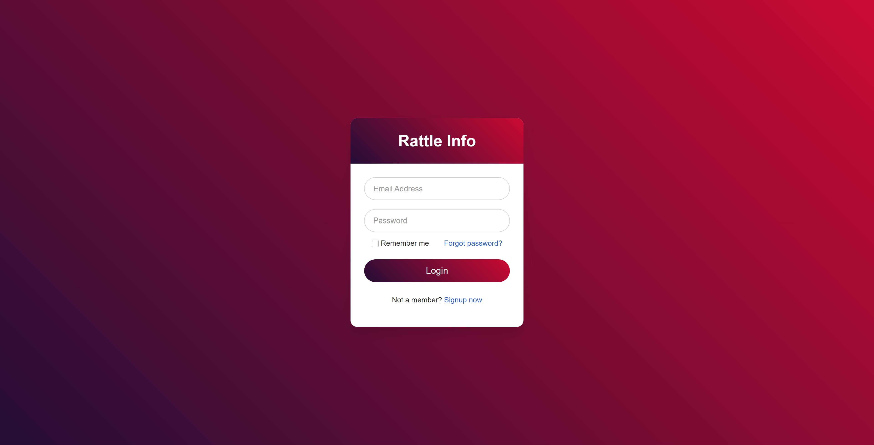
Login Page

Slide 9
Sign Up Page
I made my sign up page in a similar way to my login page as I wanted my site to look consistent. I used the same layout but changed some of the fields and added new ones for first name, last name, email, and confirm password

Slide 10
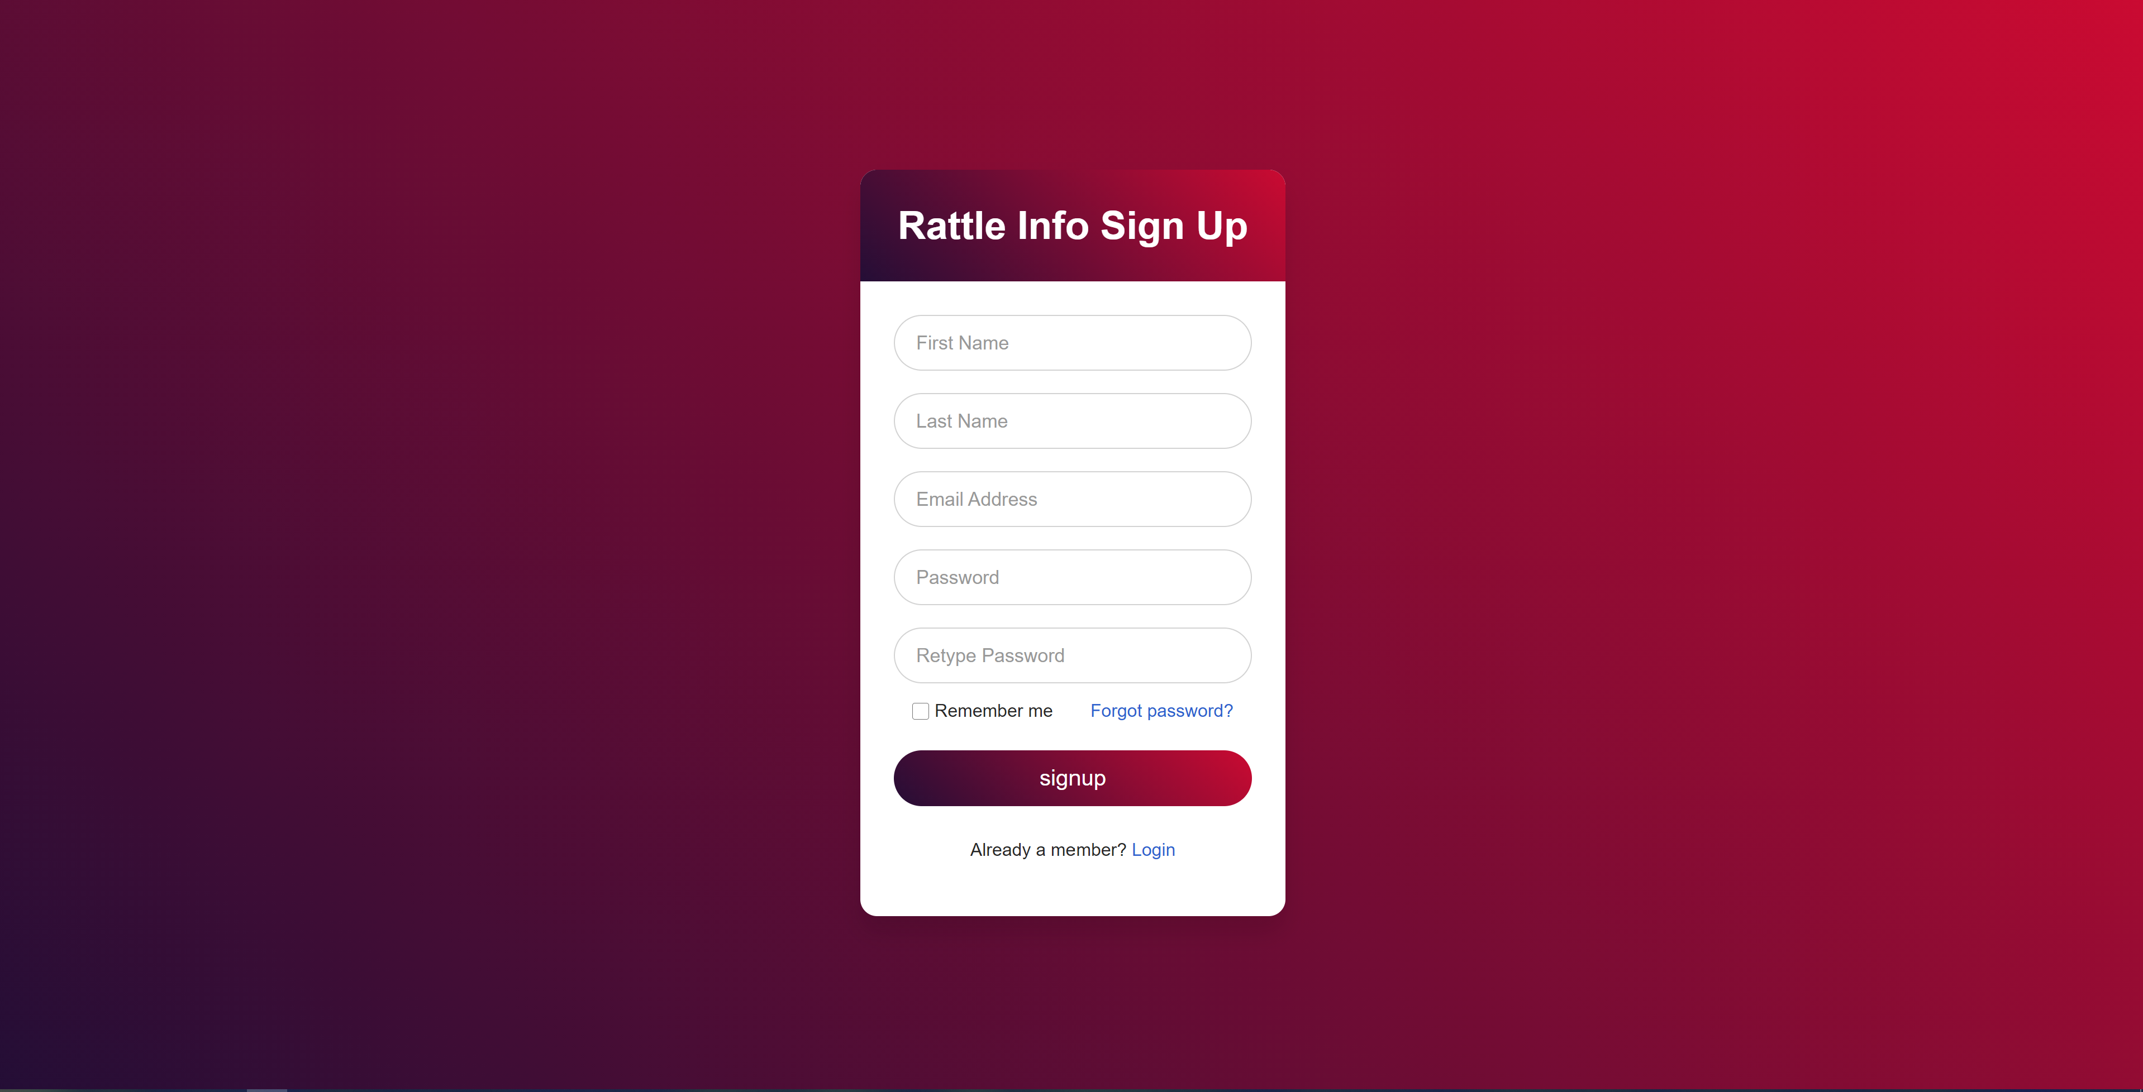
Sign Up Page

Slide 11
News Page
My news page is were I added all the articles, I did this to make navigation simple and easy for everyone, I added clickable images with the articles tittle on top as that was a simple and effective way of displaying articles without cluttering the page,

Slide 12
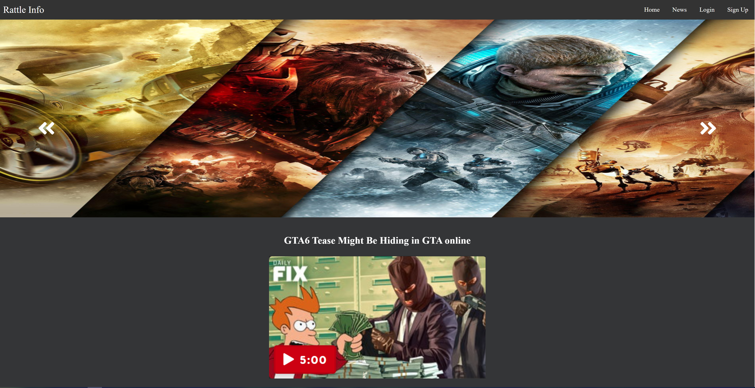
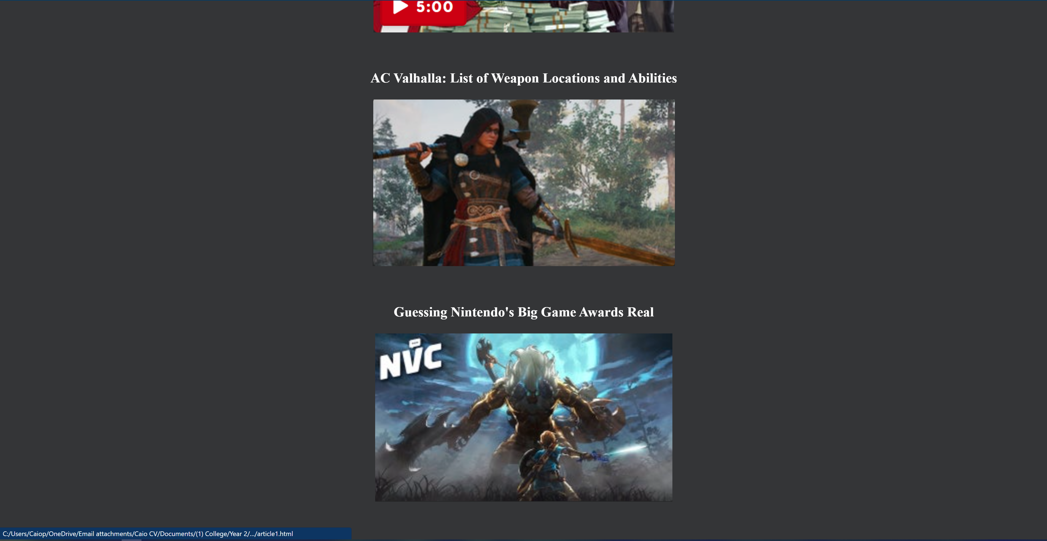
News Page

Slide 13
Article Page
For my article page, I initially didn’t know the layout I wanted, all the article pages I found online were so cluttered and filled with adds that I found it hard tell what was a picture or an add, so for my article page I kept the layout simple. I kept the nav bar and carousel, then below that I added the title of the article a picture of it, then the content of the article all centered within the middle page.

Slide 14
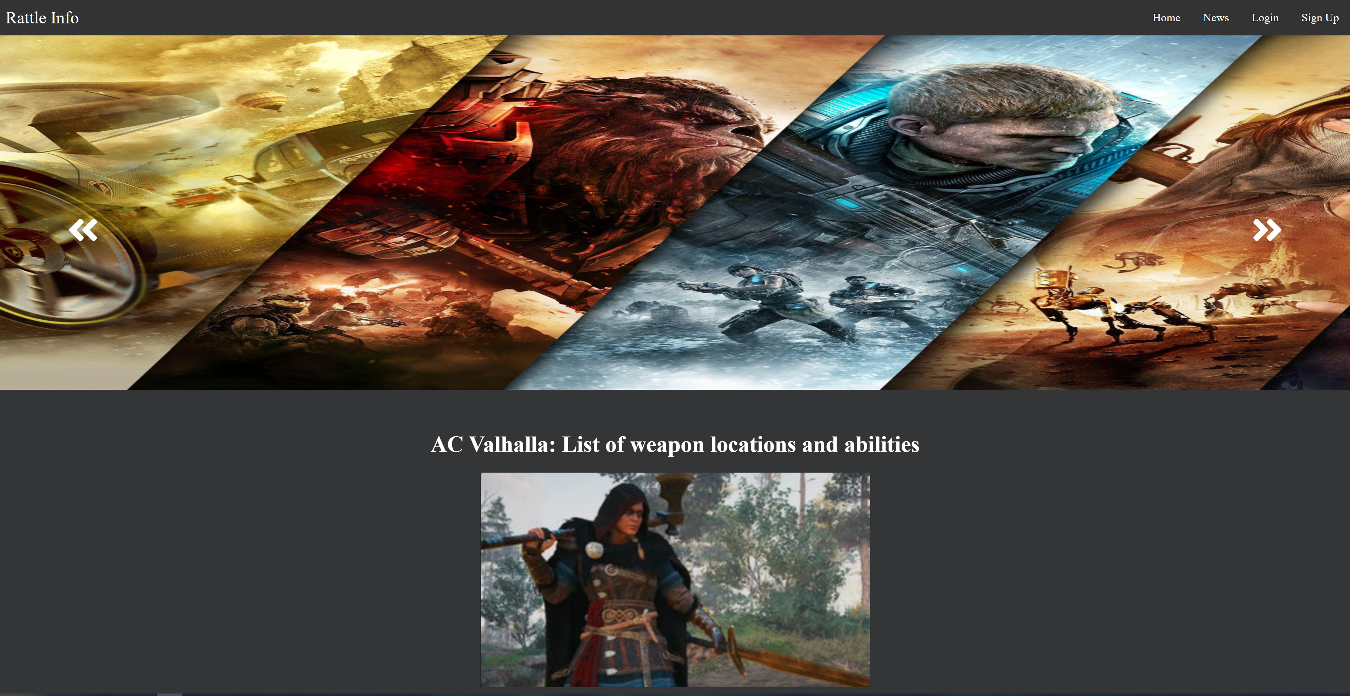
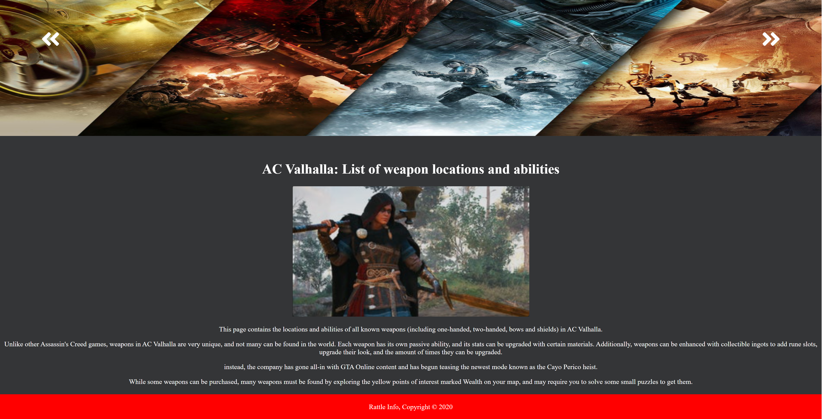
Article Page

Slide 15
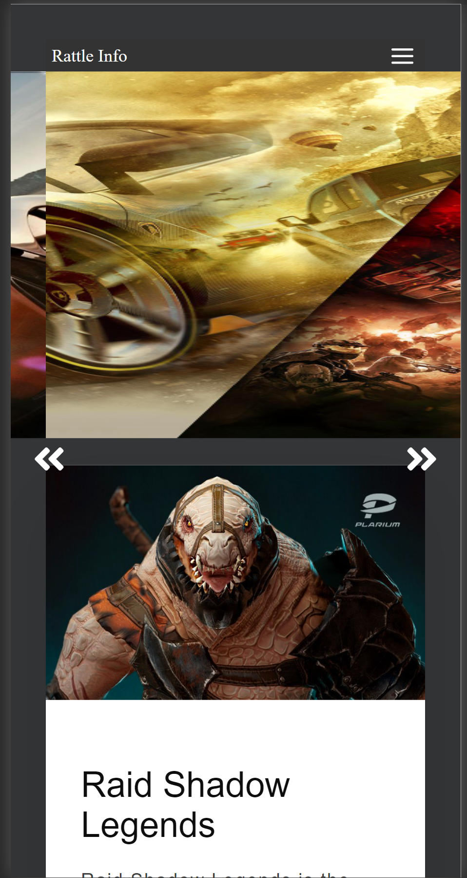
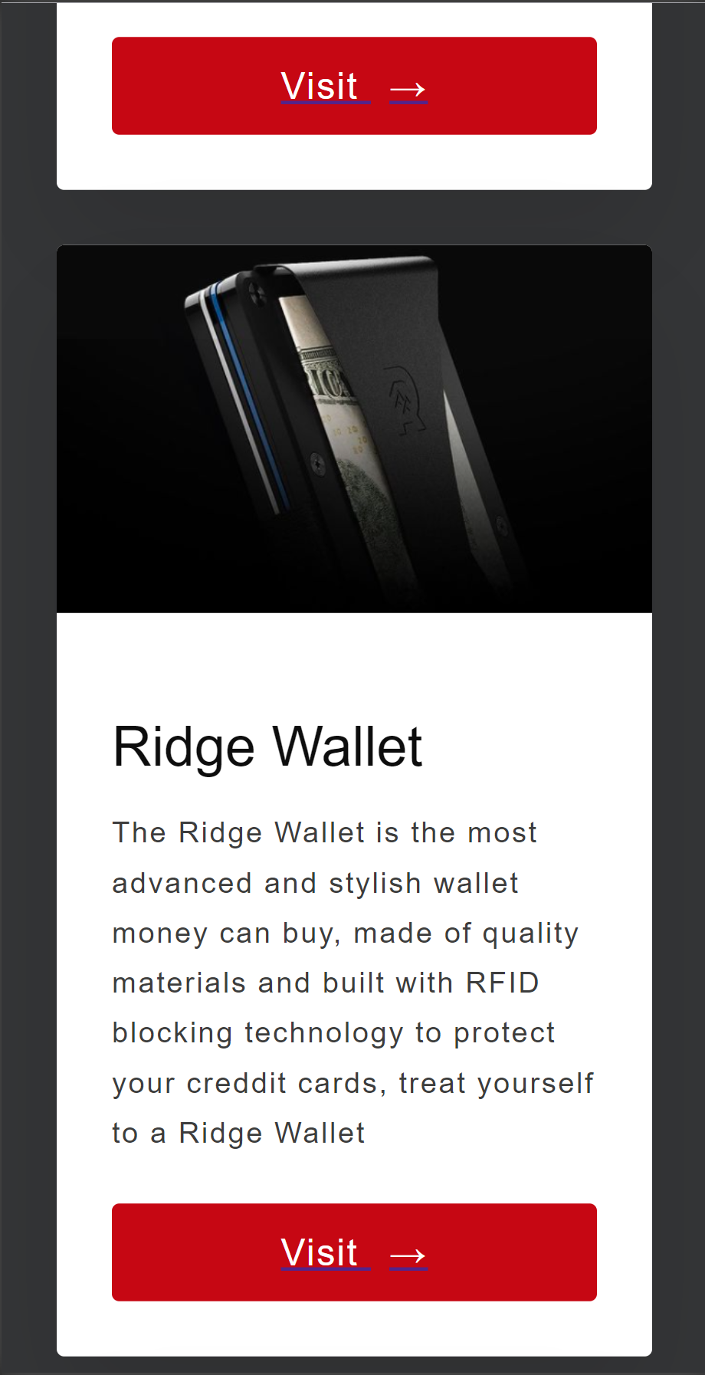
Mobile Usability
This website was supposed to be responsive for many device sizes. I took care to ensure that the nav bar was responsive and turned into a burger menu and that the content and pictures would resize as needed to fit mobile layouts

